Slide 1
Exercise session 4
Functions and lists ☺

Slide 2



We are going to try something a bit different this week…

Slide 3
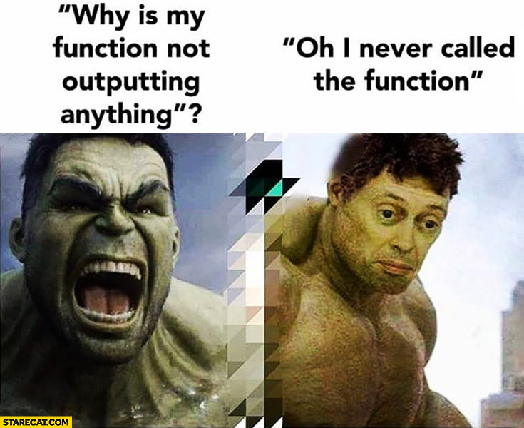
Functions
A function is a ”miniprogram” within a program
Functions you already know: print(), input(), len() and range()
Functions are useful when you have a piece of code that gets executed multiple times

Slide 4

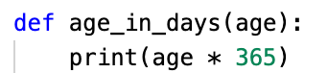

Defining a function
Calling a function
When defining a function, you essentially ”create” a function. The function is not executed simply by being defined.
A function will be executed when it is called.
A function can be called multiple times
name of the function
function call
argument
parameter
def statement
Result:
body of the function

Slide 5


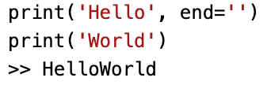

return Values = the value that a function evaluates to
return Statements = can be used to specify what the return value should be. Consist of:
- the return keyword
- the value or expression that the function should return
The None Value
- A value that represent the absence of a value
- Written with capital N
- Helpful when you need to store something that shouldn’t be confused with a real value in a variable.
- Python adds ”return None” to any function without a return statement.
Optimal parameters of the print() function
end = specifies what should be printed at the end of the argument
sep = specifies what should be printed in between arguments

Slide 6
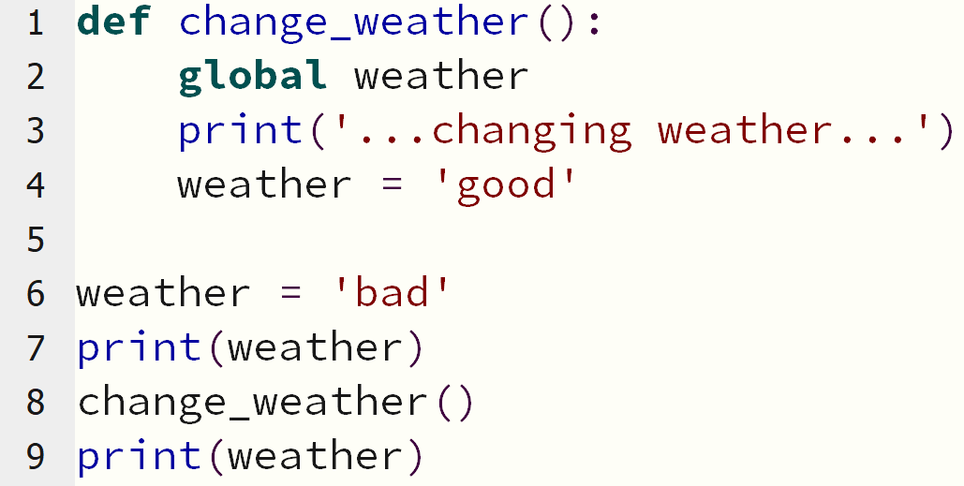
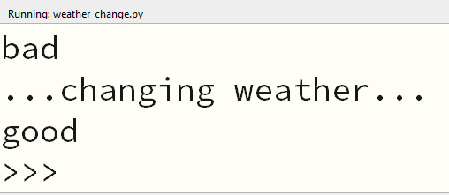
Local and global scopes
Local scope = inside a function
Global scope = outside all functions
There can be several local scopes, but there is always just one global scope
Scope matter because:
Code in the global scope cannot use any local variables
Code in the local scope can access global variables
Code in one local scope cannot access local variables from another local scope
You can use the same name for different variables if they are in different scopes
The global Statement = is used to make a ”local” variable ”global”

Slide 7


Lists
A list is a datatype that contains multiple values in ordered sequence.
Values inside a list are called items. These are separated by a comma.
Every item within a list has an index. The first item has index 0, the second has index 1 and so forth.
numbers[0]
numbers[1]
numbers[2]
numbers[3]
numbers[4]

Slide 8
Accessing items in a list
Index: 0 1 2 3 4
0
1
0
1
2
3
4
numbers[1] → 2
numbers[4] → 5
numbers[-2] → 4
0
1
Lists can also contain multiple list values. When accessing a specific item, in this case, you need to use multiple indexes:
numbers[0] → [‘food’, ‘drinks’]
numbers[1][0] → 1
numbers[-1][-3] → 3

Slide 9







Slices → getting several items from a list, creating a new list. Use square brackets with two integers separated by a colon (sometimes only one integer).
len() → returns the number of items in a list.
Changing items with indexes → you can use the index of a list to change the item of that index.
del Statement → can be used to delete an item from a list.
in and not in operators → are used to determine if an item is (or is not) in a list. The expression will evaluate to a Boolean value (True/False).

Slide 10





Methods to manipulate lists
index() → checks if an item exists in a list, if yes, its index is returned. Otherwise Python gives a ValueError.
append() → adds a new item to the end of the list.
insert() → adds a new item to the list at any index in the list.
remove() → removes an item from the list. If the value appears multiple times, only the first will be removed.
sort() → sorts the list. You cannot sort lists containing both numbers and strings.
reverse() → reverses the items of a list.

